Slide 1
How to link a local Electronic Collection (and local portfolios) to the Community Zone
Yoel Kortick
Senior Librarian

Slide 2

Introduction
The local Electronic Collection
The Electronic Collection in the Community Zone
Linking a local Electronic Collection to the Community Zone
Linking local portfolios of an Electronic Collection to the Community Zone
Linking local portfolios of an Electronic Collection to the Community Zone retroactively
Linking standalone local portfolios to the Community Zone
Agenda

Slide 3
Introduction

Slide 4
Introduction
See also Linking a Local Electronic Collection to the Community Zone
It is possible for institutions to link local Electronic Collections (including services and portfolios) to the Community Zone.
This is advantageous as it allows the institution to view and receive the Community Zone updates for these Electronic Collections and associated portfolios.

Slide 5
Introduction
When an Electronic Collection is initially linked to the Community Zone, the institution can link the Electronic Collection, the service, and all the local portfolios.
Once the Electronic Collection is linked to the Community Zone, it is possible to link local portfolios that are part of the Electronic Collection to Community Zone portfolios that are part of the Electronic Collection (see Linking a Local Portfolio that is part of a Community Zone-Linked Collection to the Community Zone for related information).
Thus, the first step in the process of linking local resources (local electronic portfolios) to the Community Zone is to link the local Electronic Collection to the Community Zone.

Slide 6
Introduction
As part of the process, Alma executes the “Link local electronic resources to the Community Zone” job to process the linking request to the Community Zone.
The results of this job are available on the Monitor Jobs page (Admin > Manage Jobs and Sets > Monitor Jobs).
Note that linking to the Community Zone is supported only for Electronic Collections with portfolios (if the local Electronic Collection does not have portfolios, the institution can instead delete the local Electronic Collection and activate it from Community Zone).

Slide 7
The local Electronic Collection

Slide 8
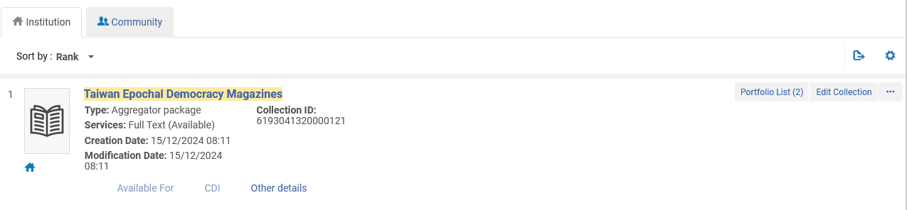
The local Electronic Collection
Currently the institution has local Electronic Collection “Taiwan Epochal Democracy Magazines” with two local portfolios
A local Electronic Collection (not linked to the Community Zone)

Slide 9
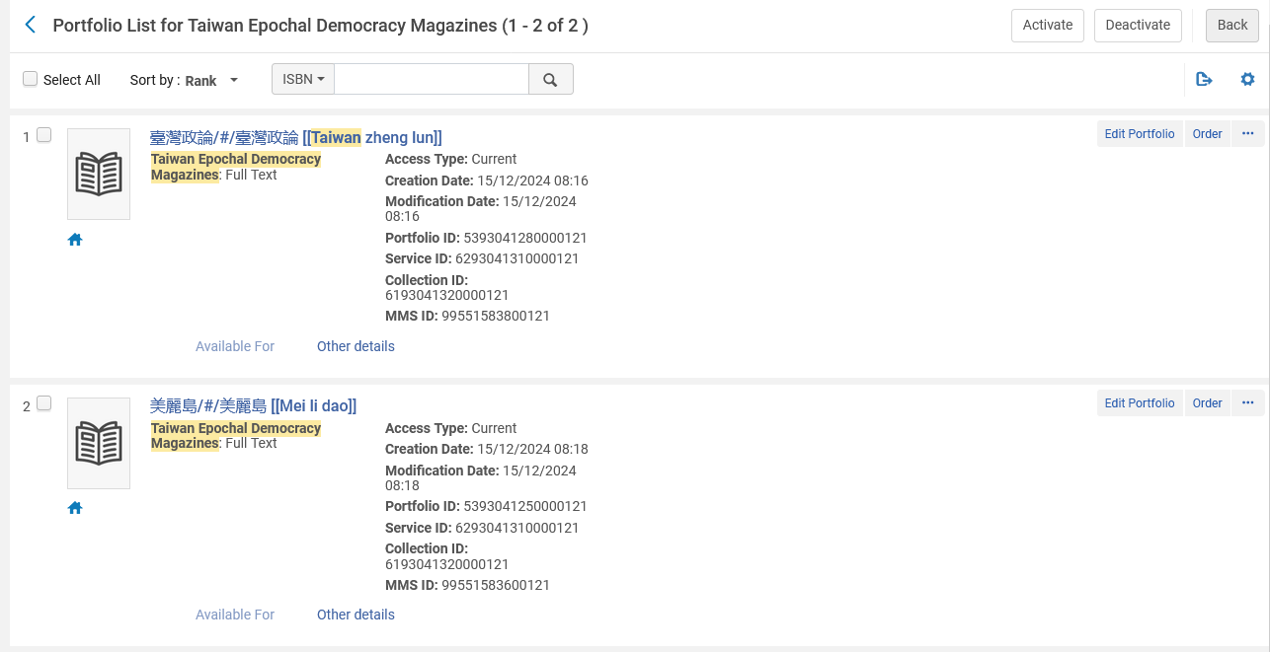
The local Electronic Collection
Here are the two local portfolios

Slide 10
The Electronic Collection in the Community Zone

Slide 11
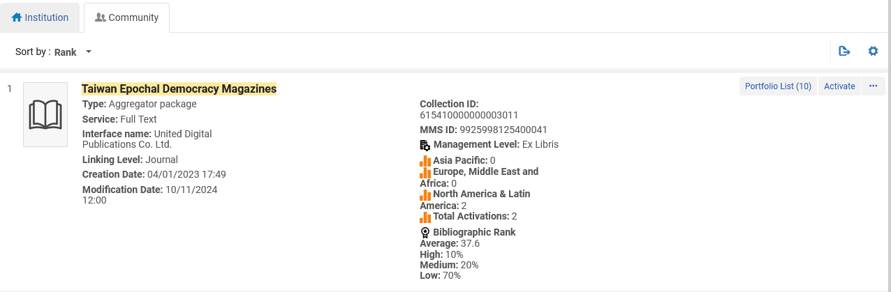
The Electronic Collection in the Community Zone
The Electronic Collection “Taiwan Epochal Democracy Magazines” also exists in the Community Zone
This Electronic Collection in the Community Zone is not linked to the Institution and therefore there is no icon here

Slide 12
Linking a local Electronic Collection to the Community Zone

Slide 13
Linking a local Electronic Collection to the Community Zone
These are the high-level steps we will follow to link the local Electronic Collection to the Community Zone:
Retrieve the local electronic collection to be linked to the Community Zone.
Select Link to Community.
Browse the Community Zone for the Electronic Collection to which the local Electronic Collection should be linked.
Select the Electronic Collection from the Community Zone list of results.
Select Yes or No for the Use the community bibliographic records option.
Click “Link”
Review the information in the dialog box and confirm.

Slide 14
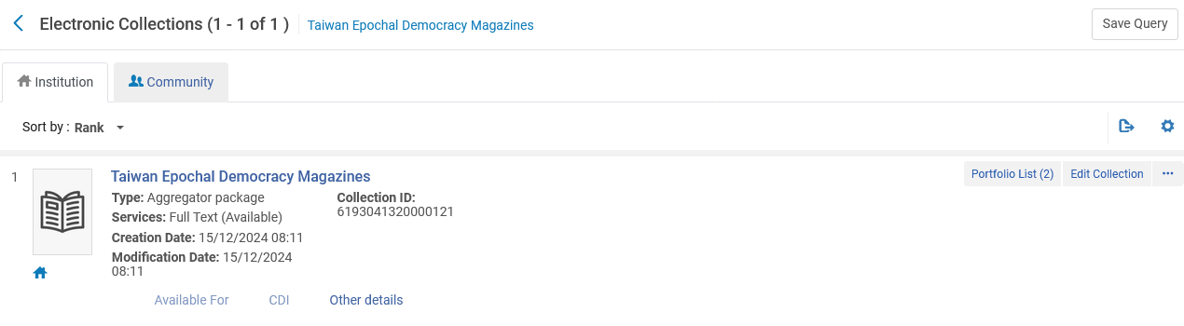
Linking a local Electronic Collection to the Community Zone
Retrieve the local electronic collection to be linked to the Community Zone.

Slide 15
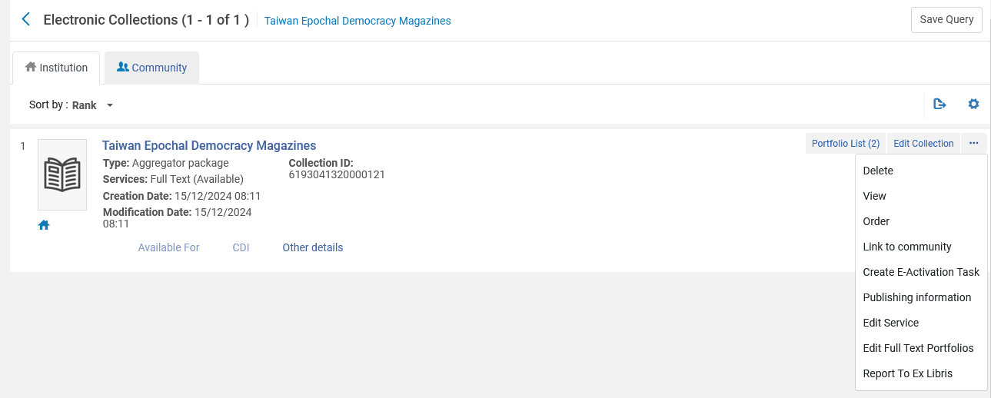
Linking a local Electronic Collection to the Community Zone
Select Link to Community.

Slide 16
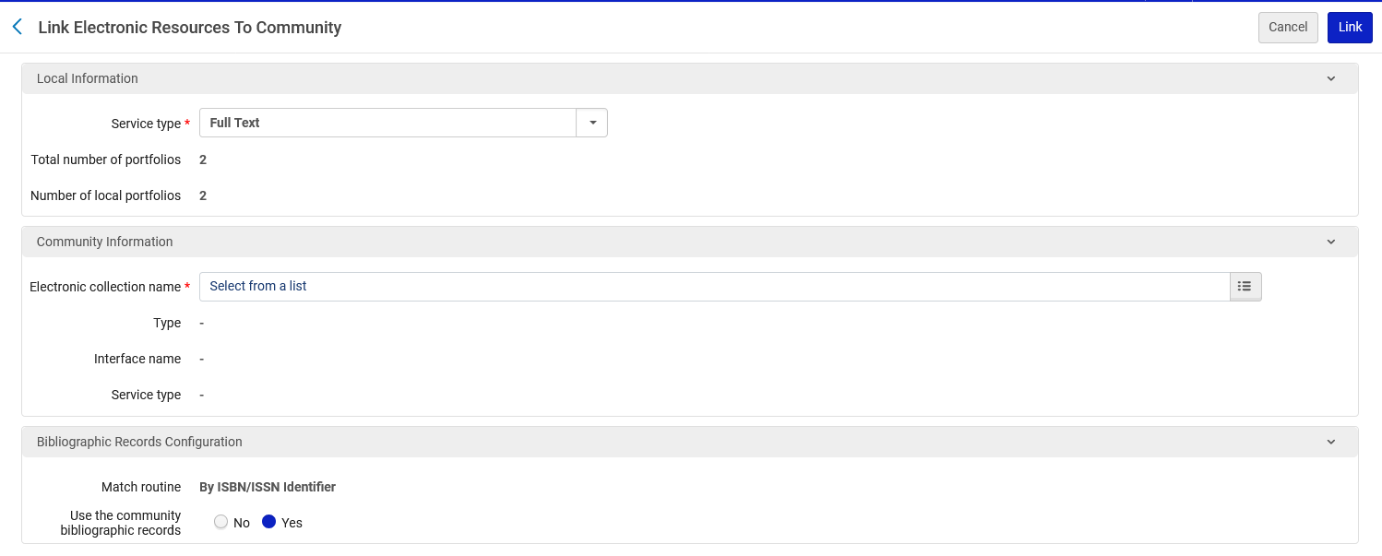
Linking a local Electronic Collection to the Community Zone
Browse the Community Zone for the Electronic Collection to which the local Electronic Collection should be linked.

Slide 17
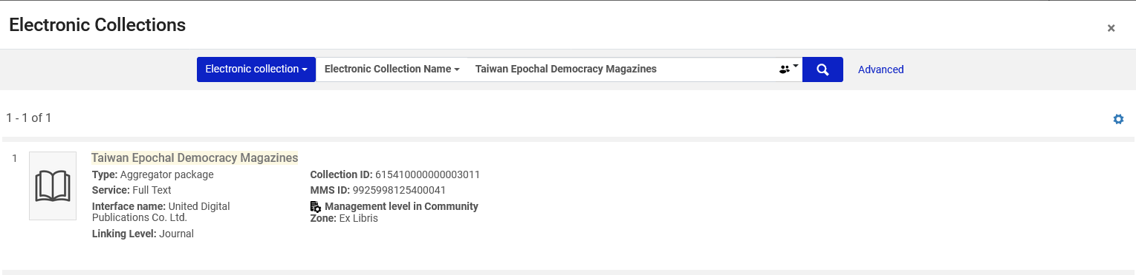
Linking a local Electronic Collection to the Community Zone
Select the Electronic Collection from the Community Zone list of results.

Slide 18
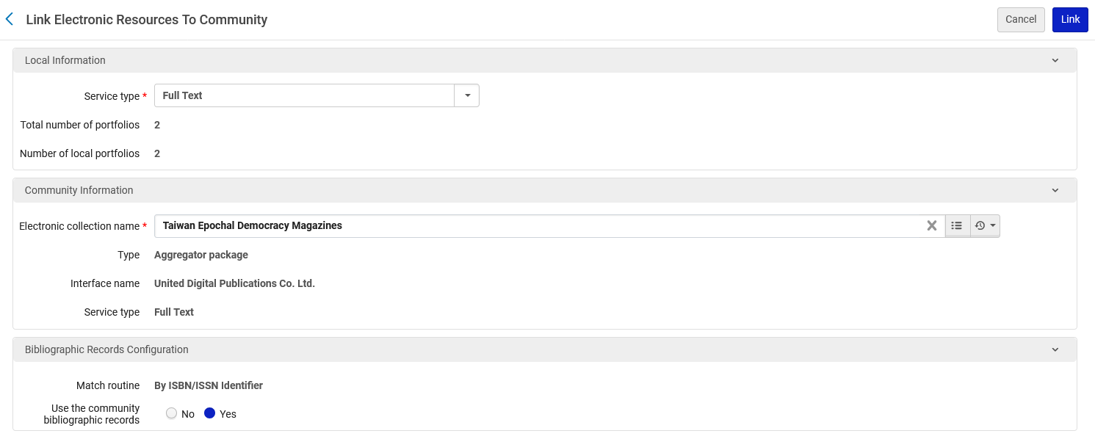
Linking a local Electronic Collection to the Community Zone
Select Yes or No for the Use the community bibliographic records option.
Here we are selecting “Yes” for “Use the community bibliographic records”

Slide 19
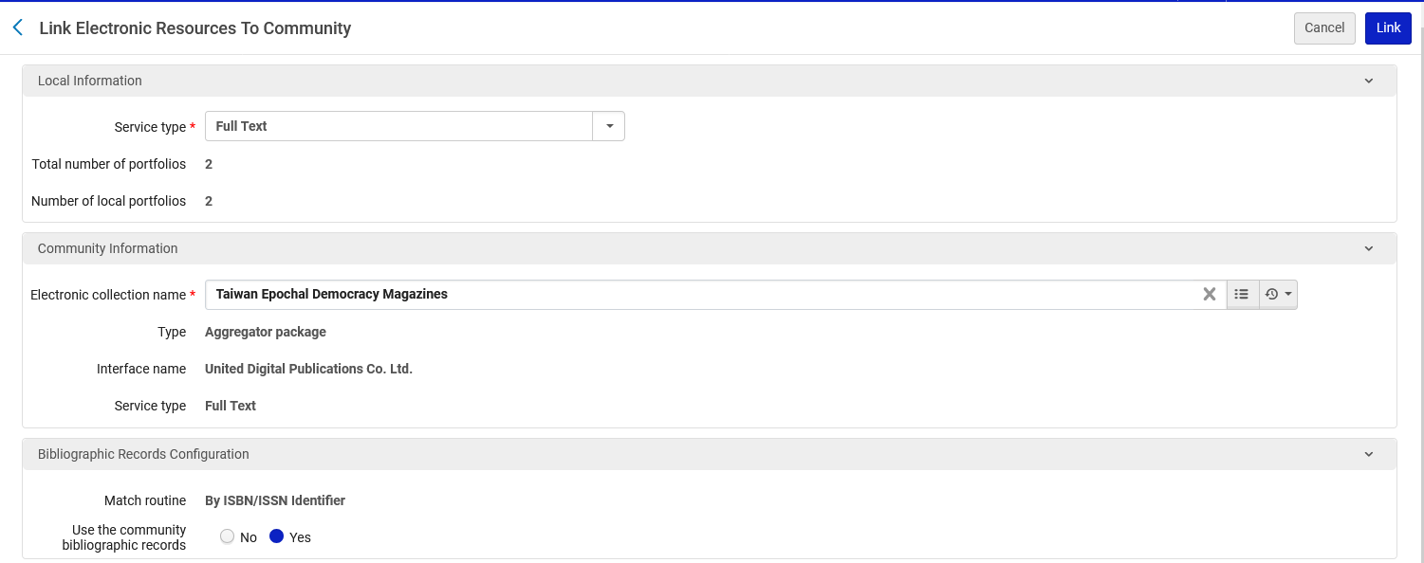
Linking a local Electronic Collection to the Community Zone
Click “Link”

Slide 20
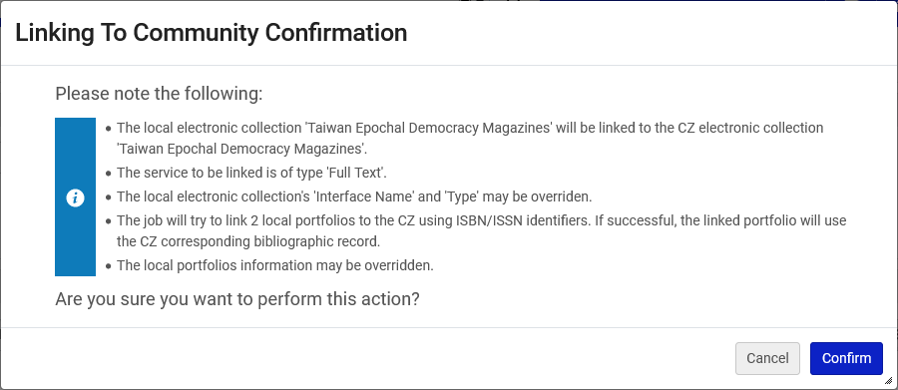
Linking a local Electronic Collection to the Community Zone
Review the information in the dialog box and confirm.
We will talk in-depth later about Linking local portfolios of an Electronic Collection to the Community Zone

Slide 21
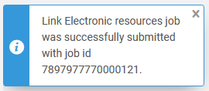
Linking a local Electronic Collection to the Community Zone
The job “Link Electronic resources” is submitted.

Slide 22
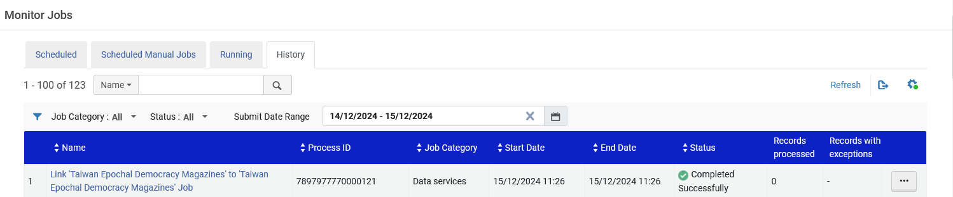
Linking a local Electronic Collection to the Community Zone
The job “Link Electronic resources” successfully completes.

Slide 23
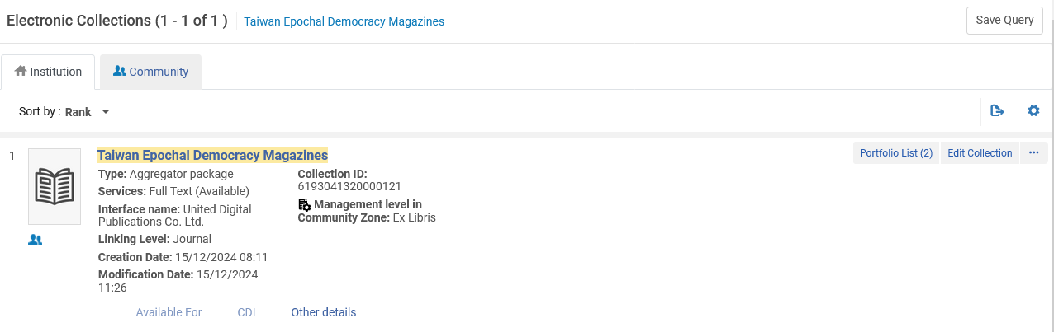
Linking a local Electronic Collection to the Community Zone
The Electronic Collection “Taiwan Epochal Democracy Magazines” is now linked to the Community Zone

Slide 24
Linking local portfolios of an Electronic Collection to the Community Zone

Slide 25
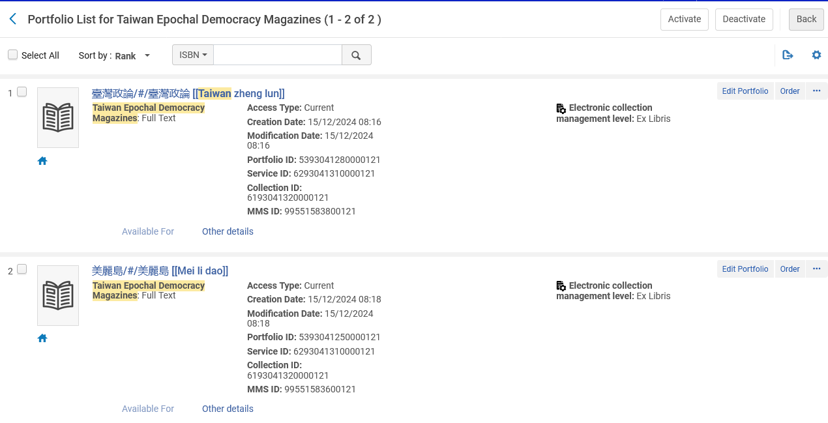
Linking local portfolios of an Electronic Collection to the Community Zone
Note that even though the Electronic Collection “Taiwan Epochal Democracy Magazines” is linked to the Community Zone”, the local portfolios (in this specific case) are not linked to the Community Zone
Icons of a local portfolio (not linked to the Community Zone)

Slide 26
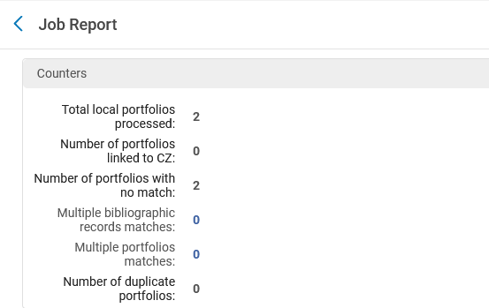
Linking local portfolios of an Electronic Collection to the Community Zone
We see from the job report “Link Electronic resources” that no match was found for the portfolios (therefore they are not linked to the Community Zone)

Slide 27
Linking local portfolios of an Electronic Collection to the Community Zone
The reason no match was found is because it uses match routine ISBN / ISSN and the bibliographic records of the portfolios do not have an ISBN or ISSN

Slide 28
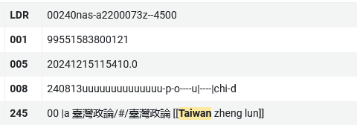
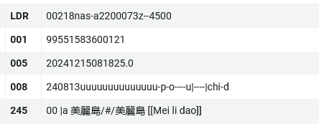
Linking local portfolios of an Electronic Collection to the Community Zone
The bibliographic records of the portfolios do not have an ISBN or ISSN
Neither record has a 020 or 022

Slide 29
Linking local portfolios of an Electronic Collection to the Community Zone
In order to demonstrate how to link local portfolios of an Electronic Collection which is linked to the Community Zone, we will do another example.
This time we will use local Electronic Collection “iG Publishing: National Taiwan University Press iG Publishing: National Taiwan University Press”.
It has two portfolios, and the bibliographic records of the two portfolios have an ISBN which is the same as the ISBN of the portfolios in this Electronic Collection in the Community Zone.

Slide 30
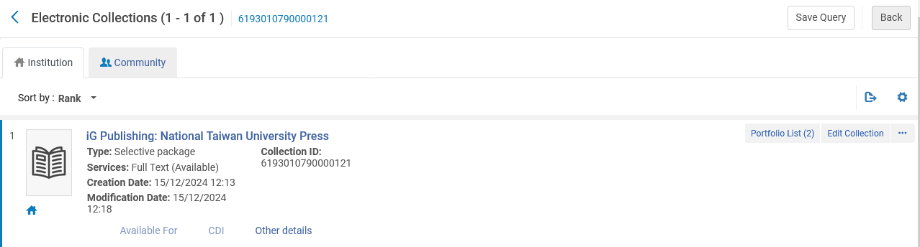
Linking local portfolios of an Electronic Collection to the Community Zone
Here is local Electronic Collection “iG Publishing: National Taiwan University Press”
The local Electronic Collection has two portfolios
A local Electronic Collection (not linked to the Community Zone)

Slide 31
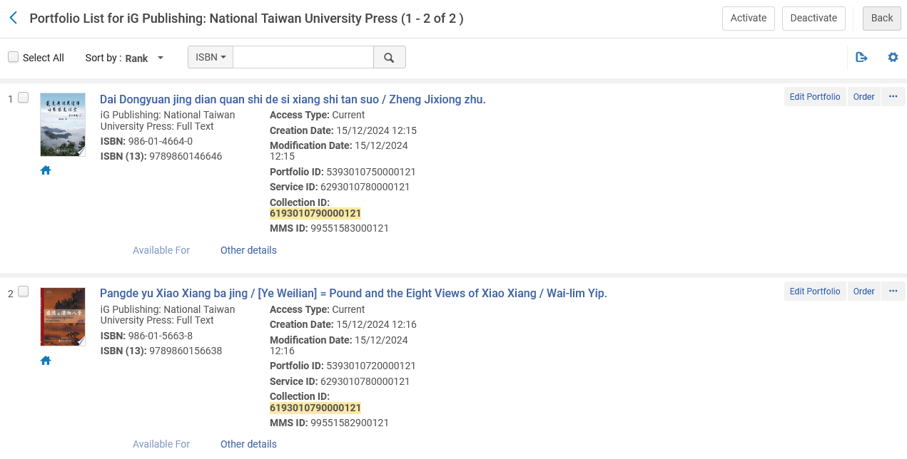
Linking local portfolios of an Electronic Collection to the Community Zone
The two portfolios in local Electronic Collection “iG Publishing: National Taiwan University Press” each have an ISBN
Local portfolios (not linked to Community Zone)

Slide 32
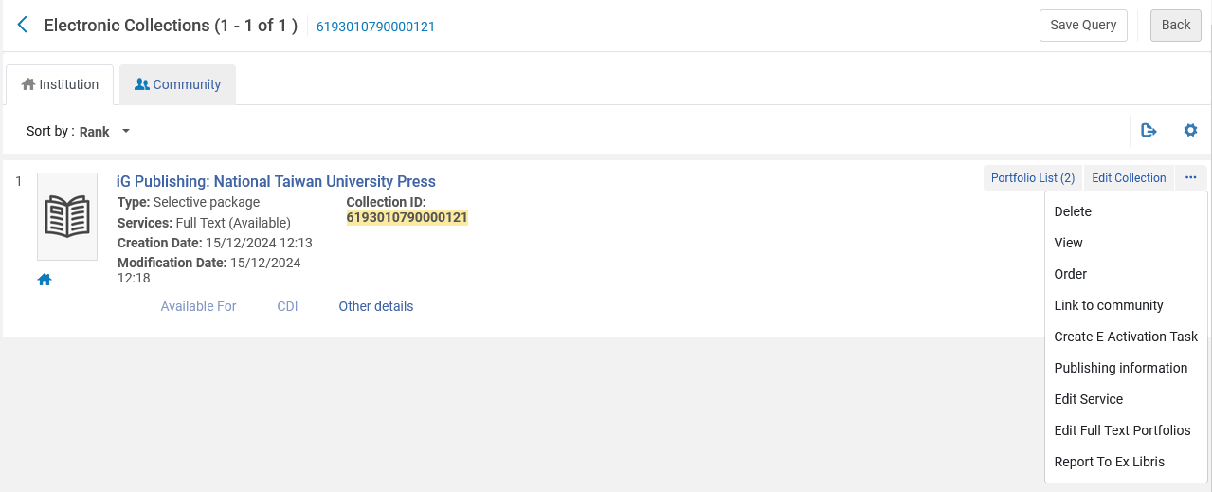
Linking local portfolios of an Electronic Collection to the Community Zone
We will link local Electronic Collection “iG Publishing: National Taiwan University Press” to the Community Zone

Slide 33

Linking local portfolios of an Electronic Collection to the Community Zone
We will link local Electronic Collection “iG Publishing: National Taiwan University Press” to the Community Zone

Slide 34
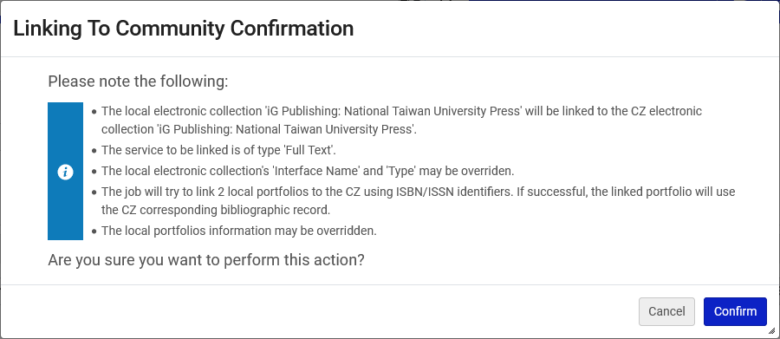
Linking local portfolios of an Electronic Collection to the Community Zone
We will link local Electronic Collection “iG Publishing: National Taiwan University Press” to the Community Zone
Now we will talk in-depth about Linking local portfolios of an Electronic Collection to the Community Zone

Slide 35
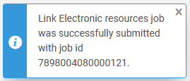
Linking local portfolios of an Electronic Collection to the Community Zone
The job “Link Electronic resources” is submitted.

Slide 36
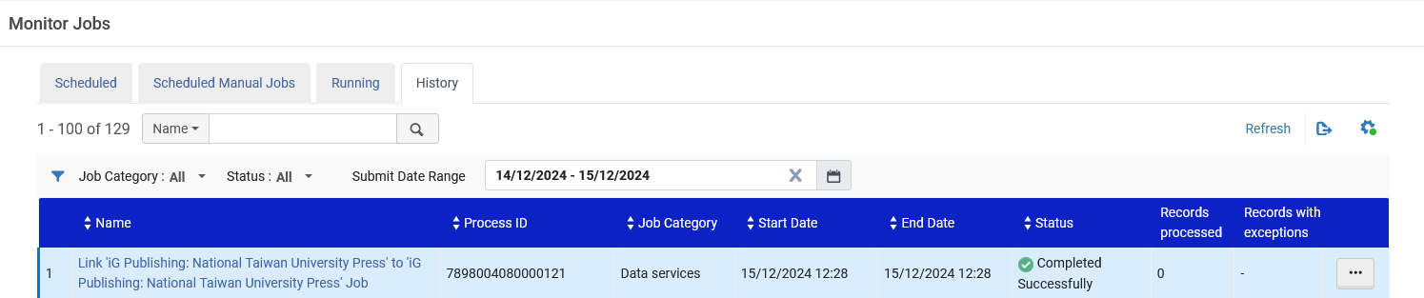
Linking local portfolios of an Electronic Collection to the Community Zone
The job “Link Electronic resources” successfully completes.

Slide 37
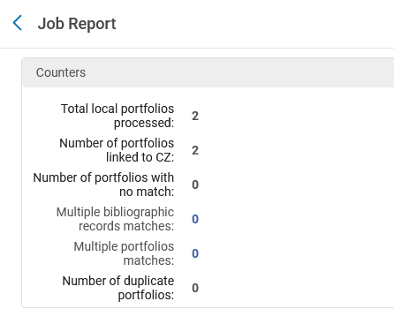
Linking local portfolios of an Electronic Collection to the Community Zone
According to the job report both portfolios have been linked to the Community Zone

Slide 38
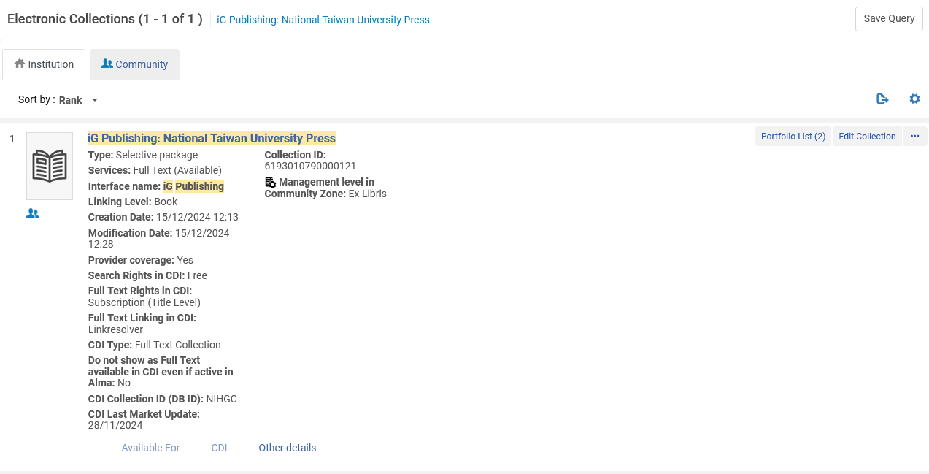
Linking local portfolios of an Electronic Collection to the Community Zone
The Electronic Collection has become linked to the Community Zone

Slide 39
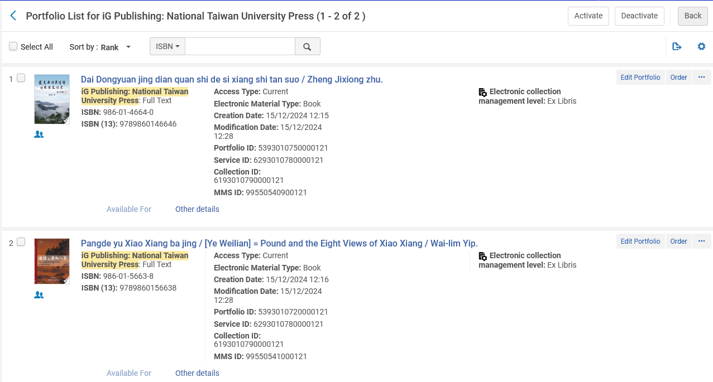
Linking local portfolios of an Electronic Collection to the Community Zone
Both portfolios of the Electronic Collection have become linked to the Community Zone

Slide 40
Linking local portfolios of an Electronic Collection to the Community Zone retroactively

Slide 41
Linking local portfolios of an Electronic Collection to the Community Zone retroactively
After a local Electronic Collection has been linked to the Community Zone, there may be cases where it still has local electronic portfolios.
In this case it is still possible to attempt to link the local electronic portfolios to the Community Zone.
This can be done as follows:
Search for the Electronic Collection in the Institution
From the row Actions choose “Edit Service”
Switch to the Portfolios Tab
Click “Link Local Portfolios to the Community”
Click “Link”
Click “Confirm”

Slide 42
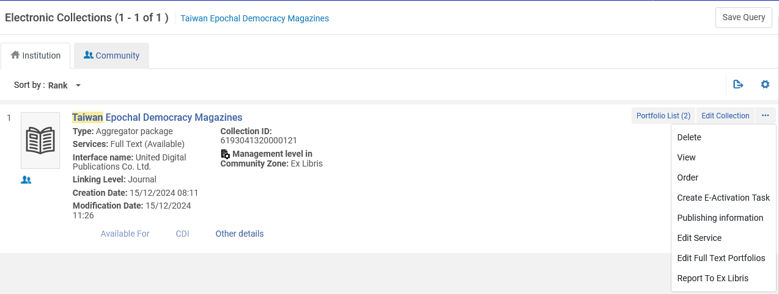
Linking local portfolios of an Electronic Collection to the Community Zone retroactively
Search for the Electronic Collection in the Institution
From the row Actions choose “Edit Service”

Slide 43
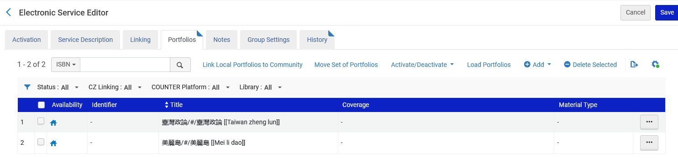
Linking local portfolios of an Electronic Collection to the Community Zone retroactively
Switch to the Portfolios Tab
Click “Link Local Portfolios to the Community”

Slide 44
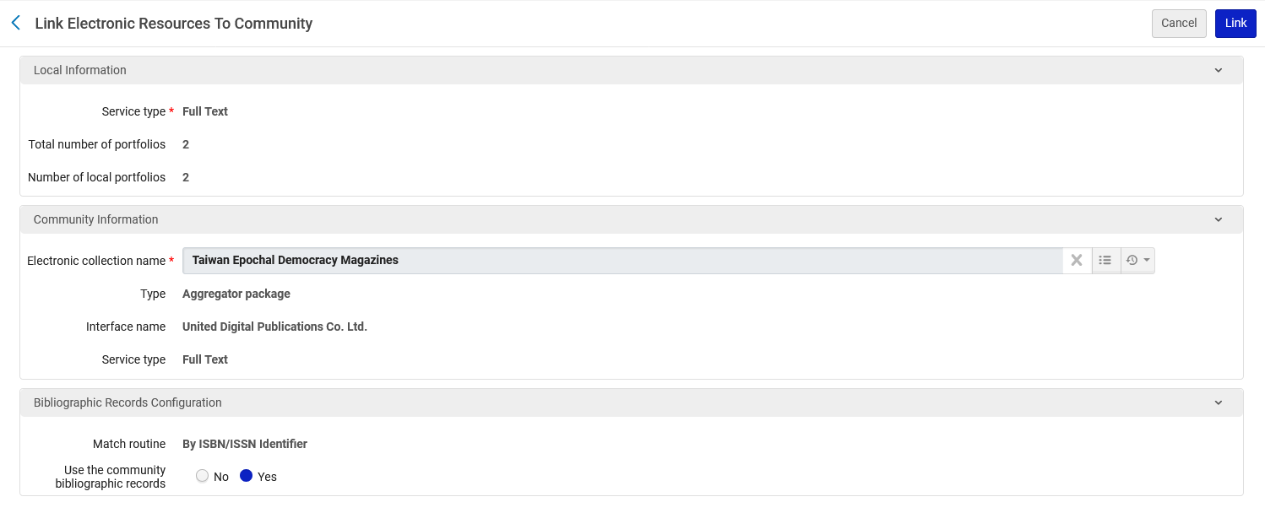
Linking local portfolios of an Electronic Collection to the Community Zone retroactively
Click “Link”
The system will attempt to link based on ISBN . ISSN

Slide 45
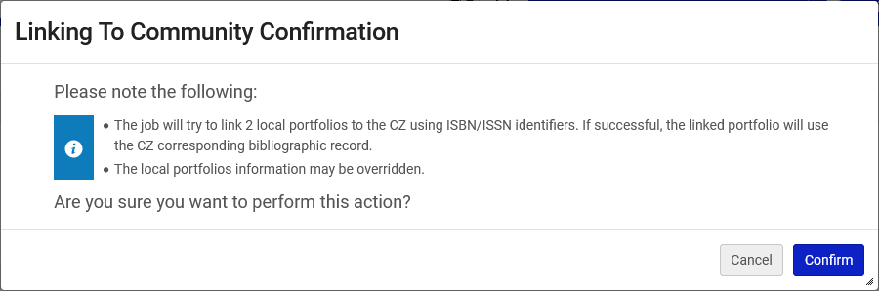
Linking local portfolios of an Electronic Collection to the Community Zone retroactively
Click “Confirm”
The system will attempt to link based on ISBN . ISSN

Slide 46
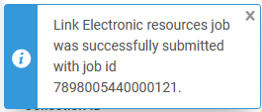
Linking local portfolios of an Electronic Collection to the Community Zone retroactively
Again, as we saw in the previous workflows, a job will be sent to attempt to link the electronic portfolios to the Community Zone records.
If a match by ISBN / ISSN will be made, then the local portfolios will become linked to the Community Zone

Slide 47
Linking standalone local portfolios to the Community Zone

Slide 48
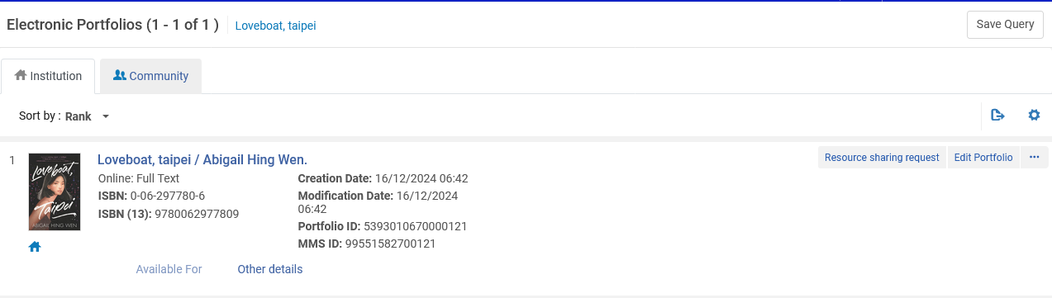
Linking standalone local portfolios to the Community Zone
It is also possible for institutions to link standalone (not part of an Electronic Collection) portfolios to the Community Zone.
Title “Loveboat, Taipei” is a local standalone portfolio.
Not part of an Electronic Collection
Does have an ISBN (to be used to match record in Community Zone)
Not linked to CZ

Slide 49
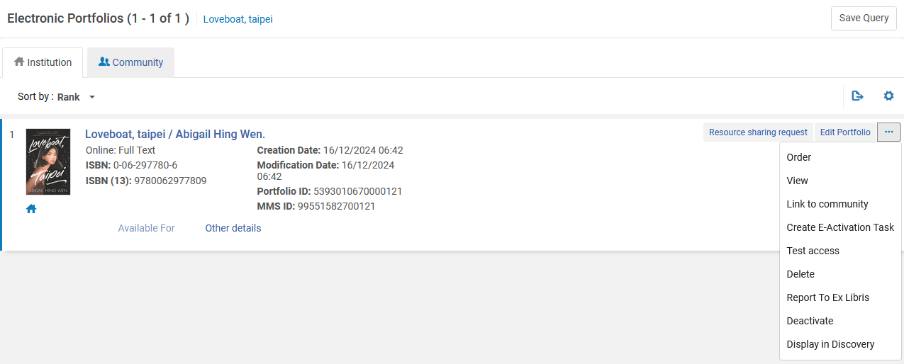
Linking standalone local portfolios to the Community Zone
From the row actions we will choose “Link to Community”

Slide 50
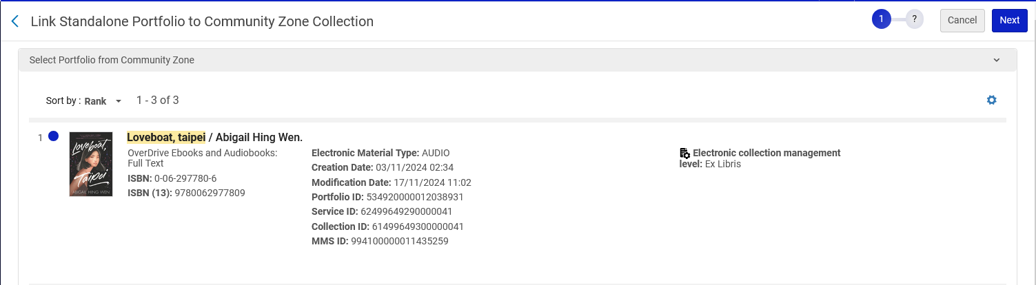
Linking standalone local portfolios to the Community Zone
If there is a match (or matches) for a portfolio (or portfolios) in the Community Zone, then they will appear on the “Link Standalone Portfolio to Community Zone Collection“ page. Select the portfolio to which it is desired to link to the Community Zone and click “Next”
Three matching portfolios were found (based on the ISBN / ISSN)
We will link to the portfolio in Electronic Collection “OverDrive Ebooks and Audiobooks”

Slide 51
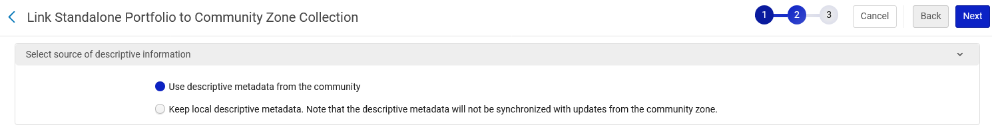
Linking standalone local portfolios to the Community Zone
Select the desired source of descriptive information and click “Next”.

Slide 52
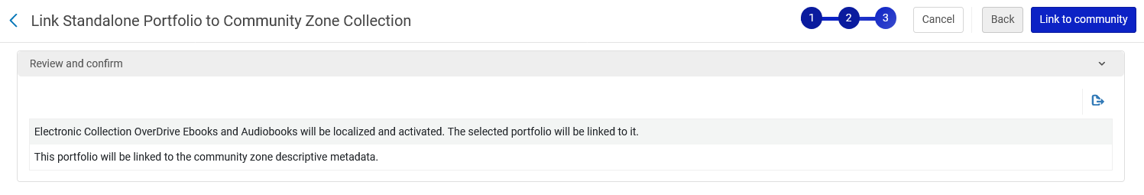
Linking standalone local portfolios to the Community Zone
Click “Link to Community” to confirm.

Slide 53
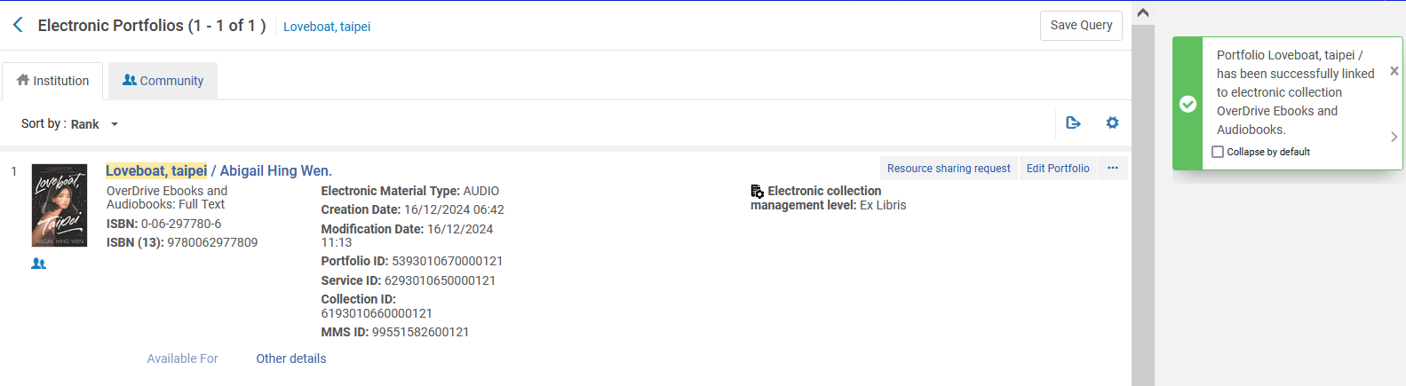
Linking standalone local portfolios to the Community Zone
The portfolio is now linked to the Community Zone
Linked to CZ

Slide 54
xxx@exlibrisgroup.com

